Slide 1

Mike Teitelbaum
Connecteam Home Assignment
February, 2025
Biz Ops Manager
Exploring Customer Journey
Pipeline Analysis and insights

Slide 2
Connecteam Home Assignment
February, 2025
Agenda
01. Assignment Overview
02. Customer Journey Wireframe (Overview)
03. Data Analysis Approach
04. Key Data Insights & Visuals
05. HubSpot Integration & Dashboard
06. Conclusion & Next Steps

Slide 3
Connecteam Home Assignment
February, 2025
Assignment Overview
Wireframe & Customer Journey
Data Analysis & Reporting
Mapping the journey from
prospect to customer..
Identifying key insights from
raw sign-up data.

Slide 4
Connecteam Home Assignment
February, 2025
Customer Journey Wireframe (Overview)
Top of Funnel
MIRO.
Marketing: Inbound channels & SDRs for outbound
SDRs: Integrated into customer journey
Sales: Pipeline stages, integrations, tools, quotas
CS: Engagement and day one alignment
Billing: Chargebee integration with HubSpot

Slide 5

Connecteam Home Assignment
February, 2025
Data Analysis
BizOp_EDA
DQ Lead Analysis
BOM Report
Key Figures
Conversion Rate: 17% (Signup → Paid) Lead Drop-off Rate: 25% at MQL → Demo stage Average Time Delays: 4 days between MQL → Demo, 7 days between Demo → Paid
Conversion Funnel Analysis
Bottleneck: 25% of leads drop off at the MQL → Demo stage, resulting in a significant reduction in conversion potential.
Stage to Stage Velocity: The average time delay between MQL → Demo is 4 days, while Demo → Paid takes 7 days, suggesting inefficiencies in these stages.
Actionable Insight: Reverse engineer to understand if it’s a process issue or a headcount issue. Reducing SLA by 1-2 days could improve sales velocity by approximately 10%.

Slide 6
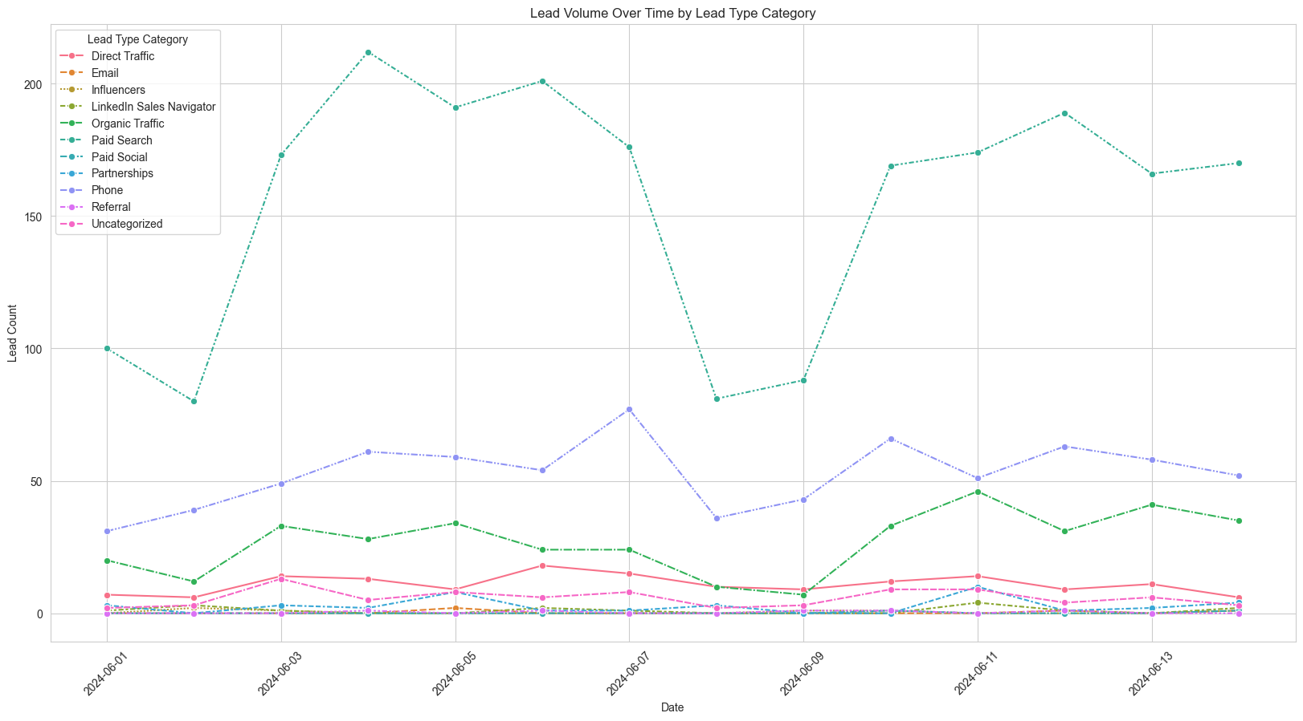
Key Data Insights
& Visuals
Patterns & Trends (Lead Volume Over Time by Lead Type Category)

Slide 7
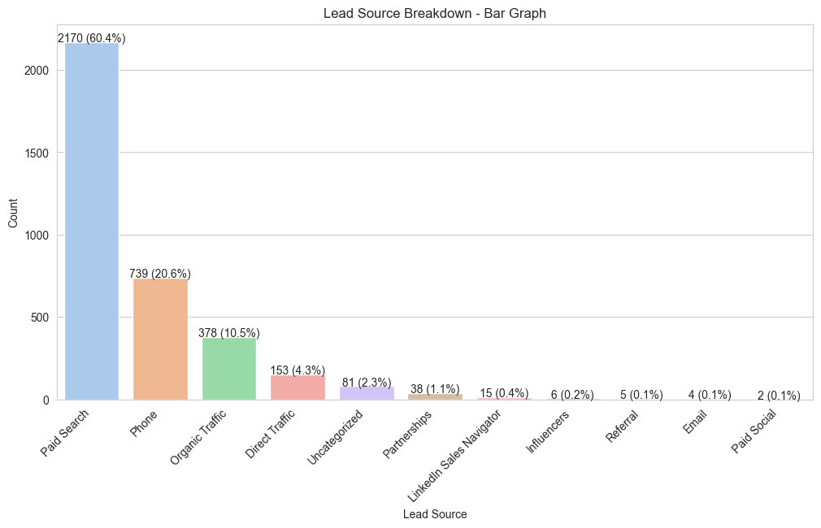
Key Data Insights
& Visuals
Patterns & Trends (Lead Source Breakdown)

Slide 8
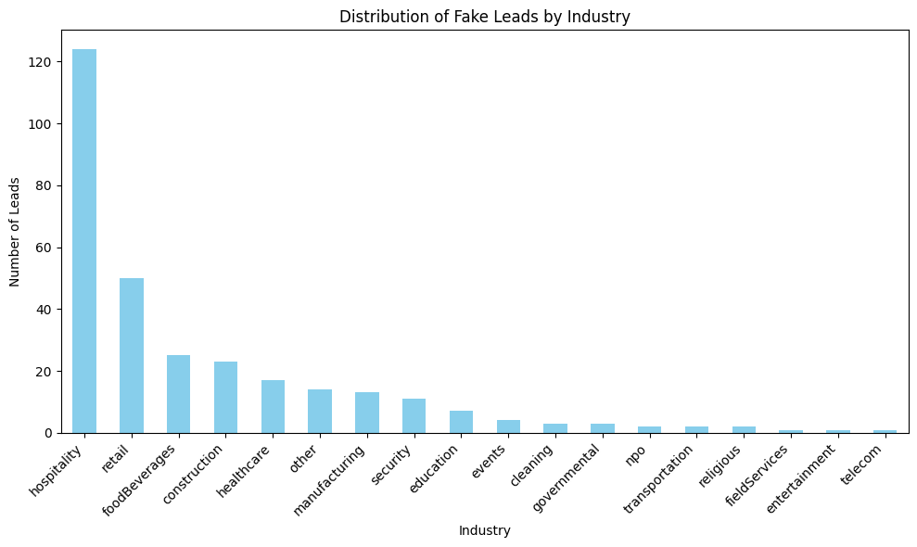
Key Data Insights
& Visuals
Patterns and Trends
(Fake Leads by industry)

Slide 9
Connecteam Home Assignment
February, 2025
Additional Metrics
Key Data Insights
🎯
Conversion Rates Overview
📌 Signup → MQL: 36.26% 📌 MQL → Demo: 30.11%
📌 Demo → Paid: 50.51%
📌 MQL → Paid: 35.02%.
🧩 What’s missing?
📊 Sales Rep Performance Data
Evaluate individual conversion rates at each funnel stage.
Identify high-performing reps and areas needing improvement.
📉 Churn & Retention Metrics
Measure post-conversion churn rates.
Set retention goals for 6+ months to reduce future drop-offs.
📢 Marketing Attribution Data
Track lead sources and link them to specific campaigns.
Optimize marketing spend by focusing on high-ROI channels.
🌍 Regions by Lead Volume
📌 North America – 2,033 leads 📌 Europe – 594 leads 📌 APAC – 582 leads 📌 Arab States – 153 leads 📌 Africa – 118 leads 📌 South America – 66 leads 📌 Israel – 40 leads 📌 Other – 5 leads

Slide 10

Developers Institute | Final Project
January, 2025
RECOMMENDATIONS FOR IMPROVEMENTS
Start pilot programs for targeted campaigns and delivery adjustments.
Monitor KPIs to evaluate success.

Slide 11
Developers Institute | Final Project
January, 2025
Understand and cater to distinct customer segments.
GOALS REVIEW
Strengthen fraud detection while ensuring minimal false positives.
Optimize delivery for high-priority orders to boost satisfaction.

Slide 12

Developers Institute | Final Project
January, 2025
Q&A and Discussion

Slide 13
Developers Institute | Final Project
January, 2025
CONTACT ME
Connect With Me Today and Let's Start Building Together!
Github
Linkedin

